Slide 1
Operating Systems
Operating Systems
Types of Operating System
Major Functions
User Interface
Examples of Operating System
1

Slide 2
Operating Systems
Operating Systems
The operating system is the most important program that runs on a computer.
Operating system is an interface between computer and user.
It is responsible for the management and coordination of activities and the sharing of the resources of the computer.
2

Slide 3
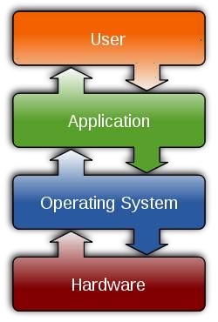
Operating Systems
3

Slide 4
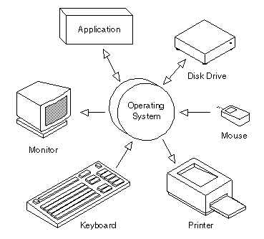
Operating Systems
4

Slide 5
Operating Systems
Types of Operating System
Multi-user vs. Single user
A multi-user operating system allows multiple users to access a computer system concurrently.
Time-sharing system can be classified as multi-user systems as they enable a multiple user access to a computer through the sharing of time.
Single-user operating systems, as opposed to a multi-user operating system, are usable by a single user at a time.
5

Slide 6
Operating Systems
Major Functions of Operating System
Resource management
Data management
Job management
Standard means of communication between User and Computer

Slide 7
Operating Systems
Major Functions of Operating System
Resource Management
The resource management function of an OS allocates computer resources such as CPU time, main memory, secondary storage, and input and output devices for use.

Slide 8
Operating Systems
Major Functions of Operating System
Data Management
The data management functions of an OS govern the input and output of data and their location, storage, and retrieval.
It also is responsible for storing and retrieving information on disk drives and for the organization of that information on the drive.

Slide 9
Operating Systems
Major Functions of Operating System
Job Management
The job management function of an OS prepares, schedules, controls, and monitors jobs submitted for execution to ensure the most efficient processing.
A job is a collection of one or more related programs
and their data.

Slide 10
Operating Systems
Major Functions of Operating System
Standard Means of Communication between User and Computer
The OS also establishes a standard means of communication between users and their computer systems.
It does this by providing a user interface and a standard set of commands that control the hardware.

Slide 11
Operating Systems
User Interface
A program that controls a display for the user (usually on a computer monitor) and that allows the user to interact with the system) .
The user interface allows the user to communicate with the operating system.

Slide 12
Operating Systems
User Interface
The user interface provides means of:
Input - allowing the users to manipulate a
system
Output - allowing the system to indicate the effects of the users' manipulation.

Slide 13
Operating Systems
Types of User Interface
Command line interface
Graphical user interface

Slide 14
Operating Systems
Types of User Interface
Command Line Interface (CLI)
A command-line
interacting with a
interface is a mechanism for computer operating system or
software by typing commands to perform specific tasks.
This method of instructing a computer to perform a given task is referred to as "entering" a command.
Accept input via keyboard only.
Not suitable for beginners.

Slide 15
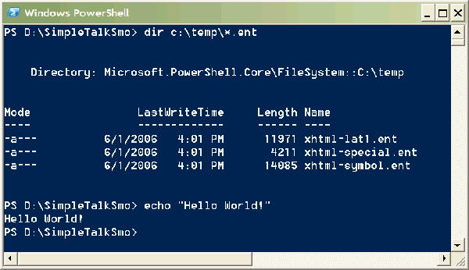
Types of User Interface
Command Line Interface (CLI)
15

Slide 16
Operating Systems
Types of User Interface
Command Line Interface (CLI)
Examples of command:
Command | Description
DIR | To display list of files or folder
COPY | To copy file or folder
MD | To make new folder
CLS | To clear screen
Quit | To quit

Slide 17
Operating Systems
Types of User Interface
Graphical User Interface (GUI)
Is a type of user interface which allows people to interact with computer with images rather than text commands.
Accept input via keyboard and pointing devices.
Easy to learn.

Slide 18
Operating Systems
Types of User Interface
Elements of Graphical User Interface
Pointer
Icons
Desktop
Windows
Menus

Slide 19
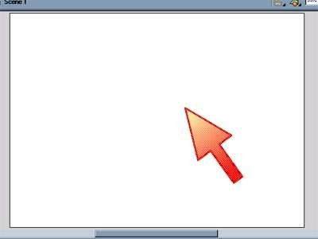
Operating Systems
Types of User Interface
Pointer
A symbol that appears on the display screen and that you move to select objects and commands.
Usually, the pointer appears as a small angled arrow.

Slide 20

Operating Systems
Types of User Interface
Icons
Small pictures that represent commands, files, or windows.

Slide 21
Operating Systems
Types of User Interface
Desktop
The area on the display screen where icons are grouped is often referred to as the desktop because the icons are intended to represent real objects on a real desktop.

Slide 22
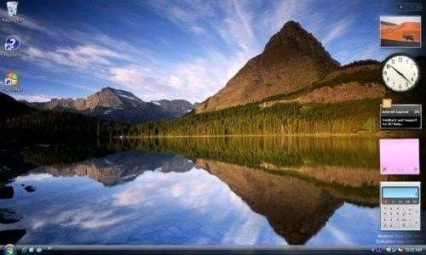
Types of User Interface
Desktop
22

Slide 23
Operating Systems
Types of User Interface
Windows
Used to divide the screen into different areas.
In each window, you can run a different program or display a different file.
23

Slide 24
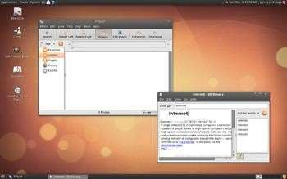
Types of User Interface
Windows
24

Slide 25
Operating Systems
Types of User Interface
Menus
Most graphical user interfaces let you execute commands by selecting a choice from a menu.
Two types of menu:
Pull-down menu
Pop-up menu
25

Slide 26
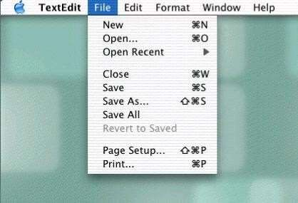
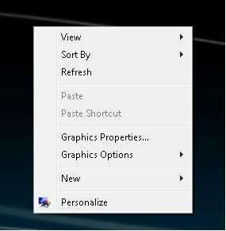
Types of User Interface
Menus
26

Slide 27
Operating Systems
Types of User Interface
 | CLI | GUI
Ease | Because of the memorization and familiarity needed to operate a command line interface, new users have a difficult time navigating and operating a command line interface. | Although new users may have a difficult time learning to use the mouse and all GUI features, most users pick up this interface much easier when compared to a command line interface.
Control | Users have much more control of their file system and operating system in a command line interface. For example, users can copy a specific file from one location to another with a one-line command. | Although a GUI offers plenty of control of a file system and operating system, the more advanced tasks may still need a command line.

Slide 28
Operating Systems
Types of User Interface
 | CLI | GUI
Multitasking | Although many command line environments are capable of multitasking, they do not offer the same ease and ability to view multiple things at once on one screen. | GUI users have windows that enable a user to view, control, and manipulate multiple things at once and is much faster to navigate when compared with a command line.
Speed | Command line users only need to use their keyboards to navigate a command line interface and often only need to execute a few lines to perform a task. | A GUI may be easier to use because of the mouse. However, using a mouse and keyboard to navigate and control your operating system for many things is going to be much slower than someone who is working in a command line.

Slide 29
Operating Systems
Examples of Operating System
MS-DOS
Windows
Mac OS
Linux
Solaris
Android

Slide 30
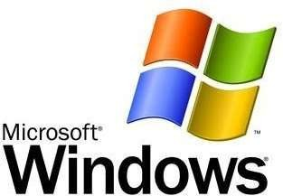
Operating Systems
Windows
Produced by Microsoft, Inc.
Using graphical user interface.
Support multitasking and
multiuser.
First version: Windows 1.0 (1985)
Latest version: Windows
8

Slide 31
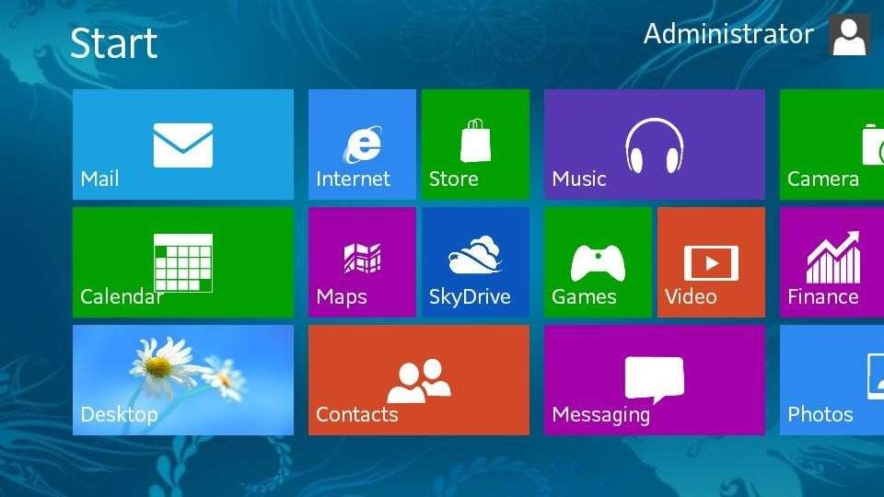
Windows
31

